Slide 1
Project Management:
Process, Technology, and Practice
Ganesh Vaidyanathan
Chapter 9
Resourcing, Costing, and Control

Slide 2
Learning objectives
Manage cost in projects
Plan and allocate resources in a project
Estimate costs and how to budget
Measure resources, schedule, and cost
Identify and measure cost variances and earned value management
Monitor and control projects
Learn how to control project performance factors

Slide 3
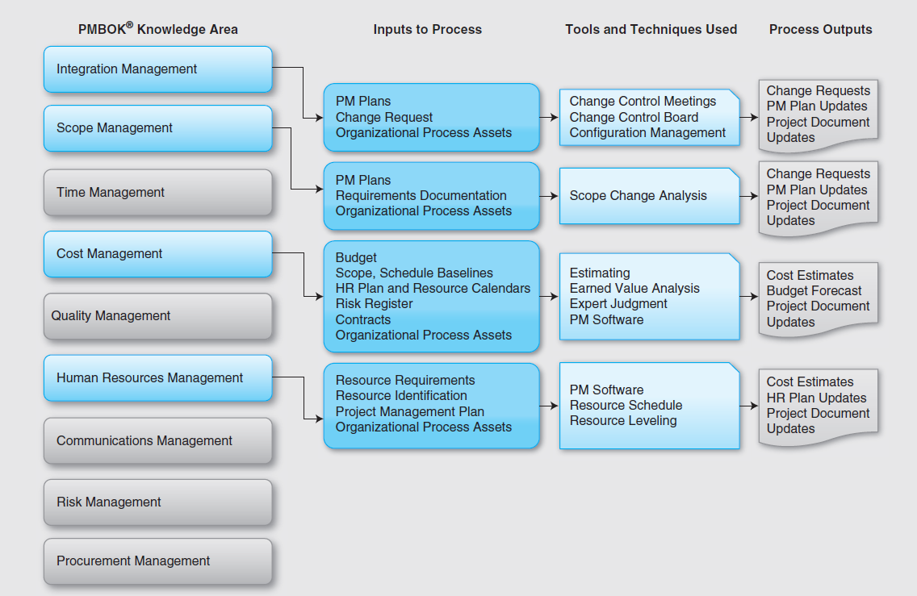

Slide 4
Monitoring and Controlling of Projects
Monitoring and controlling of project work encompasses a process of tracking, reviewing, and regulating the progress of a project to meet the performance objectives defined in the project management plan.
Projects benefit only from a properly conceived and implemented project controls strategy.
Controls are essential in managing projects to success. and if proper controls are in place and if the dynamics of the project escalation process are understood, project managers and executives can learn to avoid failure.
Monitoring a project includes collecting, measuring, and distributing important information that is accomplished throughout the length of a project.

Slide 5
Monitoring and Controlling of Projects
The monitoring and controlling of a project are associated with the following:
Comparing actual project factors such as scope, cost, schedule, resources, performance, and values against the project management plan
Identifying new risks
Analyzing, tracking, monitoring, and managing already identified risks as well as newly identified risks
Making sure that appropriate risk mitigation plans are being executed

Slide 6
Monitoring and Controlling of Projects
Assessing project performance and implementing corrective and preventive actions as necessary
Providing information to project plans using the inputs from project teams and other stakeholders
Forecasting to update current costs, resource allocations, and schedules
Monitoring implementation of approved changes as they occur

Slide 7
Integrated Change Control
Integrated change control focuses on identifying the factors that influence the proposed changes, evaluating such influences, and managing the changes in real time during project implementation.
To accomplish integrated change control, the inputs are project management plan, work performance information, change requests, environmental factors, and organizational process assets.

Slide 8
Integrated Change Control
Work performance information is essential to the project management plan and includes the following:
Progress of projects or status of projects
Progress of project deliverables or status of project deliverables
Start status and completed status of project activities
Budgeted costs versus actual incurred costs
Resource utilization details

Slide 9
Integrated Change Control Process
The integrated change control process includes reviewing all change requests, approving or denying changes, and controlling the approved changes throughout the project lifespan.
The change management activities in a project are part of the integrated change control process.
When a change request is received, the following steps have to be accomplished:
The requested change needs to be identified within the project.
The factors that are affected by the change have to be identified.

Slide 10
Integrated Change Control Process
The benefits of such a change have to be evaluated.
The criticality of the change has to be determined.
The impact of the change with respect to the six success factors has to be evaluated.
All alternative solutions including crashing, fast tracking, and critical chain project management have to be analyzed and evaluated.
The change must be communicated to key management, customers, and other stakeholders for their approval.

Slide 11
Configuration Management
Configuration management is the process of managing change in hardware, software, documentation, and measurements.
Focuses on identifying and controlling the functional and physical design of systems and products along with their supporting documentation.
It also helps to capture the revision history of the configuration item, which is the goal of baseline identification.
A baseline depicts an approved configuration item
For example, an approved scope document in its initial state that is used as a basis for comparison against future revisions of the scope document

Slide 12
Software Configuration Management
A software configuration management process is used to manage changes in software projects.
Configuration management in software projects must be defined for identification, control, accounting, and audits.
The process of identifying the attributes in a project to define every aspect of a configuration item is called configuration identification.
A configuration item can be hardware, software, or a system.
Configuration change control consists of a set of approval stages that are required to change the attribute of a configuration item. The accounting is the process of recording and reporting configuration items at any time.

Slide 13
Software Configuration Management
Configuration audits are performed during the implementation of the changes.
Software configuration management processes perform the following functions:
Verify that the software is coded to project scope
Systematic control of changes to maintain software integrity
Maintain traceability throughout the software development cycle
Verify that all planned enhancements are delivered using existing software possesses

Slide 14
Cost Management
Cost is a resource expended to achieve a specific objective, in our case, a project.
Cost management in projects is the process by which companies control and plan the costs of implementing projects.
Before a project is started, the anticipated costs should be identified.
These costs should then be evaluated and approved before any procurement.
During the implementation of a project, all costs should be recorded, tracked and monitored to control the costs and kept in line with initial expectations.

Slide 15
Project Costs
Direct costs: Direct material and labor costs used solely for a project
Indirect costs: Any material and labor costs that are not used in a single project
Fixed costs: Remain constant regardless of changes in the level of project activities
Variable costs: Vary in direct proportion to changes in the level of project activities
Overhead costs: Primarily those indirect costs associated with project implementation
General and administrative costs: Costs primarily associated with general management and administration of the project

Slide 16
Project Costs
Tangible costs: Quantifiable costs related to an identifiable resource or asset
Intangible costs: Unquantifiable costs relating to an identifiable source
Sunk costs: Incurred costs that cannot be changed by any decision and that cannot be recovered
Opportunity costs: Potential benefit given up when an alternative activity is selected over another activity

Slide 17
Direct and Indirect Costs

Slide 18
Sunk Costs
A sunk cost is an expense that cannot be recovered.
Sunk costs should not affect your decision making.
For example, if a piece of machinery was bought five years before a current project for the current project. If the machinery cannot be used now, that amount of money has already been spent and cannot be recovered. In this case, it should also not affect the company's decision on whether or not to buy a new piece of machinery.
It is like buying a ticket for a show and finding out that the show was really unbearable and you had to walk out in the middle of the show. The cost of the show is a sunk cost.
Sunk costs in a project should be forgotten.

Slide 19
Profits and Revenues
Profit is revenues of an organization minus the costs borne by the organization including the project costs. To increase the profit of an organization, its project costs have to decrease or revenues should increase or both.
A profit margin is a ratio of profitability calculated as net income divided by revenues, or net profits divided by sales. It measures how much out of every dollar of sales a company actually keeps in earnings.
If in 2010, an organization has a net income of $100 million from sales of $500 million, Profit Margin: 100M/500M = 20%,
In 2011, the organization’s net income rises to $150 million on sales of $800 million. Profit Margin: 150/800 = 18.75%; profit margin has decreased.

Slide 20
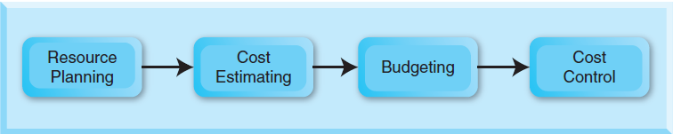
Cost Management Process
Costs are estimated using resource planning.
The estimated costs are budgeted by an organization, and the project manager controls the budget.
A project that stays within budget is usually an exception, not the rule.
A project manager has to control schedule, performance, scope, value, and resources in order to control the costs.

Slide 21
Resource Planning
The planning of the resources used to execute the project
To accomplish resource planning:
List the required resource
Quantify the required resource
Construct a resource schedule, and
Level the resources

Slide 22
List Resources
List all required resources based on WBS. Each task listed in WBS demands particular skills or knowledge. Based on this information, resources can be identified and listed.
Labor: Identify all the roles involved in undertaking the project, including all full-time, part-time and contracting roles.
Equipment: Identify all of the equipment involved in undertaking the project. For example, equipment may include personal computers, photocopiers, mobile phones, telecommunications equipment such as switches, routers and machinery, for example, heavy and light machinery.
Materials: Identify all non-consumable materials to complete project activities such as office materials and materials required for construction including lumber, steel and concrete.

Slide 23
Quantify Resources
All identified resources are subject to some specification. This next step is to describe such specifications of each resource.
Labor: List skills and experiences required by all roles and quantify how many of such resources are needed.
Equipment: List the specification of all equipment, the total quantity needed, and dates of requirement.
Materials: List the specification of all required materials and the total quantity.

Slide 24
Construct schedule
Resources required to complete the project
Timeframes for the consumption of each resource
Quantity of each resource required per week
Total quantity of resource consumed per week

Slide 25
Resource Schedule
Table 12-2. Equipment and Materials Resource Schedule
Activity | Description | Required resources | Required resources | Timeframe | Requirements per week | Quantity consumed per week
A | Scope documentation | Bob | PC, MS Office, Printer | 11/10/10 to 11/15/10 | 40 hrs
 |  | Dan | PC, MS Office, Printer | 11/12/10 to 11/23/10 | 40 hrs
B | Project planning | Ed | PC, MS Office, MS Project, Printer | 11/24/10 to 12/14/10 | 40 hrs
 |  | Frank | PC, MS Office, MS Project, Printer | 11/24/10 to 12/14/10 | 40 hrs
C | Buy materials | Gary | Wood, Nails & Screws | 12/15/10 to 2/8/11 | 40 hrs
D | Prototype design | Ian | PC, AutoCad | 12/15/10 to ¼/11 | 40 hrs
 |  | Jake | PC, AutoCad | 12/15/10 to ¼/11 | 40 hrs
 |  | Katie | PC, AutoCad | 12/15/10 to ¼/11 | 40 hrs
E | Prototype analysis | Linda | PC, FEA software | 1/5/11 to 2/15/11 | 40 hrs
 |  | Mary | PC, FEA software | 1/5/11 to 2/15/11 | 40 hrs
F | Prototype implementation | Linda | Wood, Nails & Screws | 2/16/11 to 3/22/11 | 40 hrs | Wood: 300 ft Fasteners: 100 Glue: 5 lbs.
 |  | Mary | Wood, Nails & Screws | 2/16/11 to 3/22/11 | 40 hrs | Wood: 300 ft Fasteners: 100
G | Testing of prototype | Nancy | Tester | 3/23/11 to 4/19/11 | 40 hrs
 |  | Oliver | Tester | 3/23/11 to 4/19/11 | 40 hrs
H | Presenting prototype to customer | Pam | PC, MS PowerPoint | 4/20/11 to 5/3/11 | 40 hrs

Slide 26
Resource Leveling
When the project is large and contains many resource over-allocations, resource leveling must be accomplished.
Purpose is to create a smoother distribution of resource usage.
Leveling is done by delaying or splitting tasks until the resources assigned to them are no longer over-allocated.
Before the leveling is attempted, schedule must be refined
by adding more resources
by deciding and allocating over-time policies for certain individuals
by splitting the tasks with others who are under-allocated
Leveling extends the project time.

Slide 27
Resource Leveling
Resource leveling aims to minimize the period-by-period variations in resource loading by shifting tasks within their slack allowances.
Resource leveling is accomplished by heuristics or “rule of thumb”.
A resource-leveling heuristic is a method to flatten the schedule when resources are over-allocated. The general idea is to prevent team members not overextended on activities.

Slide 28
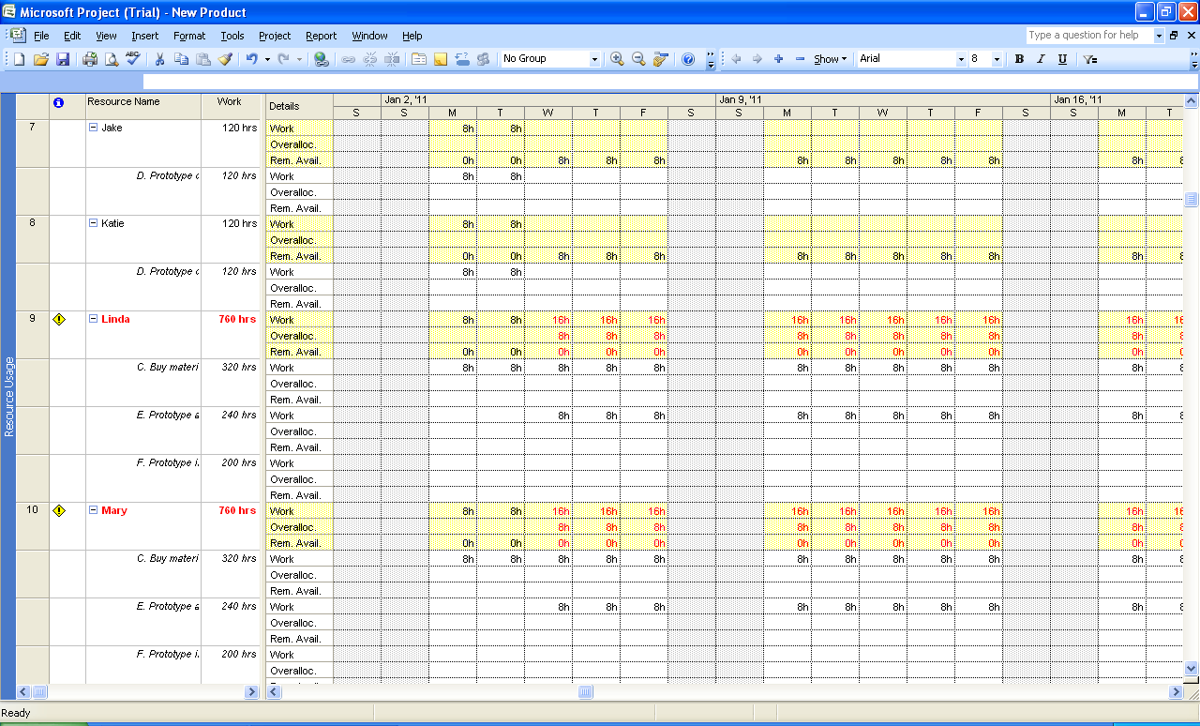
Resource Leveling

Slide 29
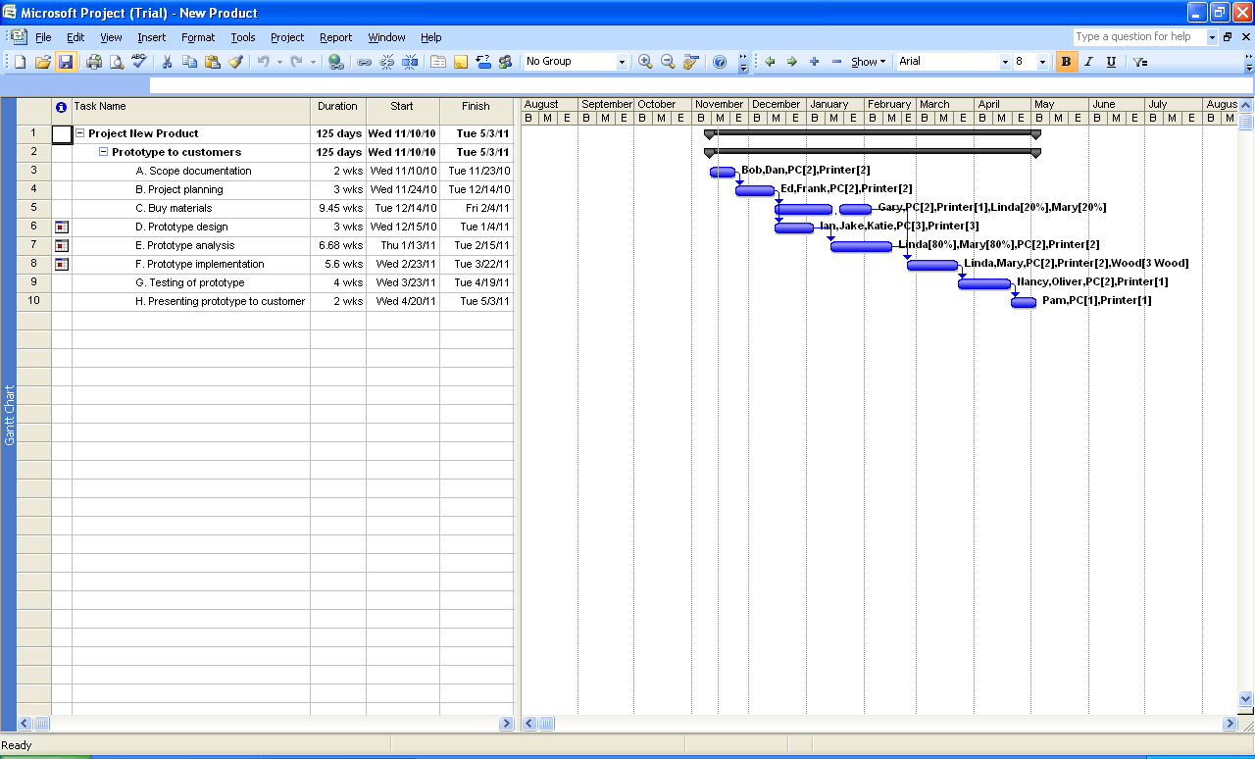
Resource Leveling

Slide 30
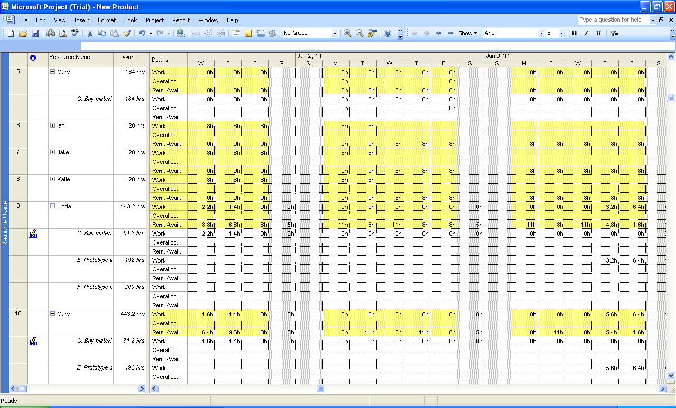
Resource Leveling

Slide 31
Cost Estimation
Budgetary rough order of magnitude estimate (BROME)
Approximate historical estimate (AHE);
Definitive estimate (DE)

Slide 32
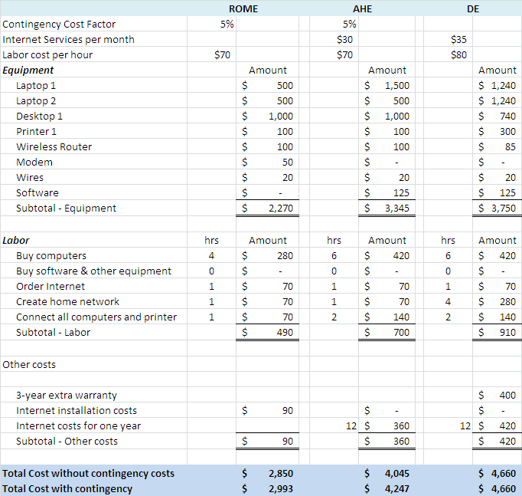
Cost Estimation

Slide 33
Budgeting
Baseline budgets must identify direct costs, indirect costs, and contingency costs to stakeholders.
Detailed estimates can be prepared by using WBS. Detailed estimates are usually done before the start of a project and after completing WBS.

Slide 34
EVA
To monitor and manage costs, project managers use an Earned Value Analysis (EVA).
EVA is primarily used to measure and track costs and schedules in a project.
The analysis uses “work in progress” to indicate the future of a project.

Slide 35
EVA
Planned Value (PV): Budgeted amount of cost for work scheduled to be accomplished on a given activity for a given period of time
Earned Value (EV): Budgeted amount of cost for competed work of a given activity for a given period of time
Actual Cost (AC): Actual amount spent in completing the work accomplished within a given time period
Cost Variance (CV): The cost variance compares deviations only from the budget and does not include schedule into account
Schedule Variance (SV): The schedule variance compares deviations only from the schedule and does not include cost into account

Slide 36
EVA
Cost Performance Index (CPI): Ratio of earned value to actual cost; if CPI>1 , project under budget
Schedule Performance Index (SPI): Ratio of earned value to planned value; if SPI >1, then project behind schedule

Slide 37
EV Equations
Earned Value | Earned Value Equation
PV: Planned Value | Planned completion % * Budget at completion
EV: Earned Value | Actual completion % * Budget at Completion
AC: Actual Value | Actual costs
CV: Cost Variance | EV – AC
SV: Schedule Variance | EV – PV
CPI: Cost Performance Index | EV / AC
SPI: Schedule Performance Index | EV / PV
EAC: Estimate at Completion | (AC/EV) * Budget at completion
ETC: Estimate to Complete | EAC – AC
VAC: Variance at Completion | Budget at Completion – EAC

Slide 38
EVA
Hidalgo, Inc., a cloud computing company is interested in purchasing and installing a new server. They estimate this activity of a major project for scalability of their company offerings to last a week and cost $20,000 including hardware, software, and installation. Let us discuss these variables with this example. This $20,000 is the baseline budgeted cost of the project. The Budget at Completion (BAC) is also $20,000. Hidalgo, Inc. wants to monitor the progress. They find that at the end of the second day of the five-day week, they have completed 25% of the work and they have spent $9,000. The planned activity had 30% completion at the end of the second day.

Slide 39
EV Equations
PV: Planned Value | $ 6,000
EV: Earned Value | $ 4,000
AC: Actual Value | $ 9,000
CV: Cost Variance | ($ 5,000)
SV: Schedule Variance | ($ 2,000)
CPI: Cost Performance Index | 0.44
SPI: Schedule Performance Index | 0.66
EAC: Estimate at Completion | $ 45,000
ETC: Estimate to Complete | $ 36,000
VAC: Variance at Completion | ($25,000)

Slide 40
Variances
Question on project | What should be used?
How much work is planned? | PV
How much work is done already? | EV
How much have we spent so far? | AC
What is the total cost of the project? | BAC
What do we expect project cost to be now? | EAC
What is the estimate to complete the project? | ETC
What is the future of this project? | VAC

Slide 41
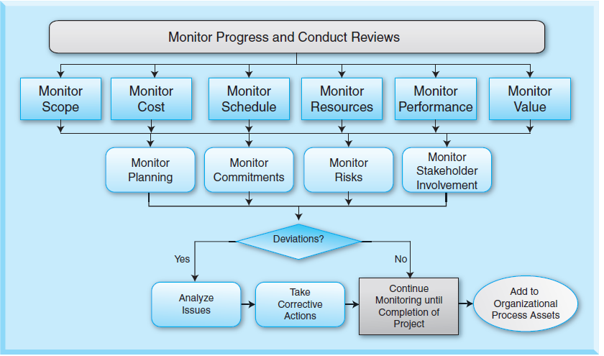

Slide 42
Summary
Cost is one of the major factors in the success of a project.
Cost is a resource expended to achieve a project and is measured as a monetary amount.
Profits are revenues of an organization minus the costs borne by the organization including the project costs. A profit margin is a ratio of profitability calculated as net income divided by revenues or net profits divided by sales.
Project costs may be tangible or intangible, direct or indirect, or sunk.
The cost management process includes resource planning, cost estimating, budgeting, and cost control.

Slide 43
Summary
A resource plan includes all physical resources required to complete a project including labor, equipment, and materials. Four steps are usually taken to complete resource planning: list the required resources, quantify the required resources, construct a resource schedule, and level the resources.
When the project is large and contains many resource over-allocations, resource leveling must be accomplished. The purpose of resource leveling is to create a smoother distribution of resource usage; it is performed by delaying or splitting tasks until the resources assigned to them are no longer over-allocated.

Slide 44
Summary
The level of effort and expertise needed to accomplish cost management is high in most projects. There are three common methods employed in estimating costs of projects: budgetary rough order of magnitude estimate, approximate historical estimate, and definitive estimate.
Organizations may choose to use learning curves for some of their repetitive tasks. Learning curves may be used in conjunction with approximate historical estimate as well.
A rough order of magnitude estimate provides a rough estimate of what a project costs before the actual project has started; project managers use this estimate for project selection.

Slide 45
Summary
Approximate historical estimates are made without detailed knowledge of a project. They are also called top-down estimates and are used for budgetary purposes.
The detailed estimate is prepared from well-developed plans, vendor quotes, specifications from customers, and quotes from suppliers and contractors.
The accuracy of ROME is usually between –25 percent and +75 percent; the accuracy of AHE is between –10 percent and +25 percent; and the accuracy of DE is about –5 percent to +10 percent.

Slide 46
Summary
To monitor and manage costs, project managers use an Earned Value Analysis (EVA).
EVA uses “work in progress” to indicate the future of a project. While traditional methods of accounting focus on planned expenditure and actual costs, EVA examines actual cost at any period during the progress of a project. This provides project managers greater insight into potential risk areas and allows them to plan ahead with risk mitigation plans based on actual cost, schedule, and technical progress of the work.
EVA provides project managers an “early warning” and enables them to identify and control problems before they become out of control.

Slide 47
Class Discussions
All projects overrun cost estimations and therefore we do not need cost estimations.
Cost monitoring is good for only big projects.
There is no value in cost estimation and monitoring.
Project managers should remain firm when handling resource commitments during projects.
There are no good ways to level resources.
Project managers should always use detailed estimates.
Project managers should not be allowed to buffer estimates.
Is project team morale critical to project success?

Slide 48
